Slide 1
Consumer Staples
Joel Forwalder
Ryan Frank
Michael Kerr

Slide 2
Table of Contents
Topics of Discussion
I. Overview
Slide 3
II. Business Analysis
Slide 7
III. Economic Analysis
Slide13
IV. Financial Analysis
Slide 23
V. Valuation Analysis
Slide 30
VI. Recommendation
Slide 39

Slide 3
I. Overview

Slide 4



Overview
Consumer Staples Performance vs S&P 500 YTD
Market Cap: $3.35/24.06T
Companies in SIM Portfolio
S&P 500 Sector Weightings

Slide 5





Overview
Sub-Sectors
Major Companies
Food Products
Beverages
Food & Staples Retailing
Household Products
Personal Products
Tobacco
Consumer Staples by Sub-Sector

Slide 6
Overview
Staples Sub-Sector Performance YTD
 | Personal Products | Beverages | Tobacco | Household Products | Food & Staples Retailing | Food Products
YTD Performance | 23.6% | 10.8% | 8.3% | 5.2% | 1.4% | (-7.7%)

Slide 7
II. Business analysis

Slide 8
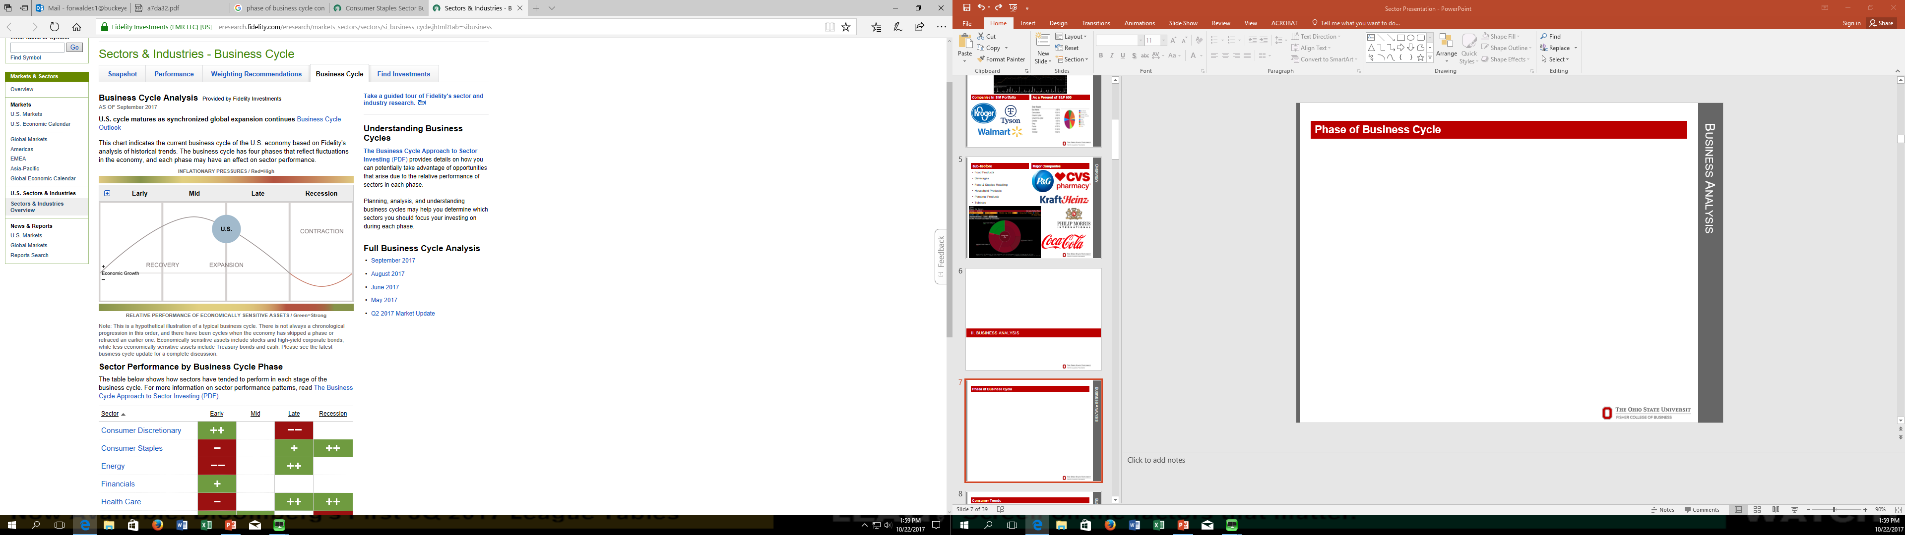
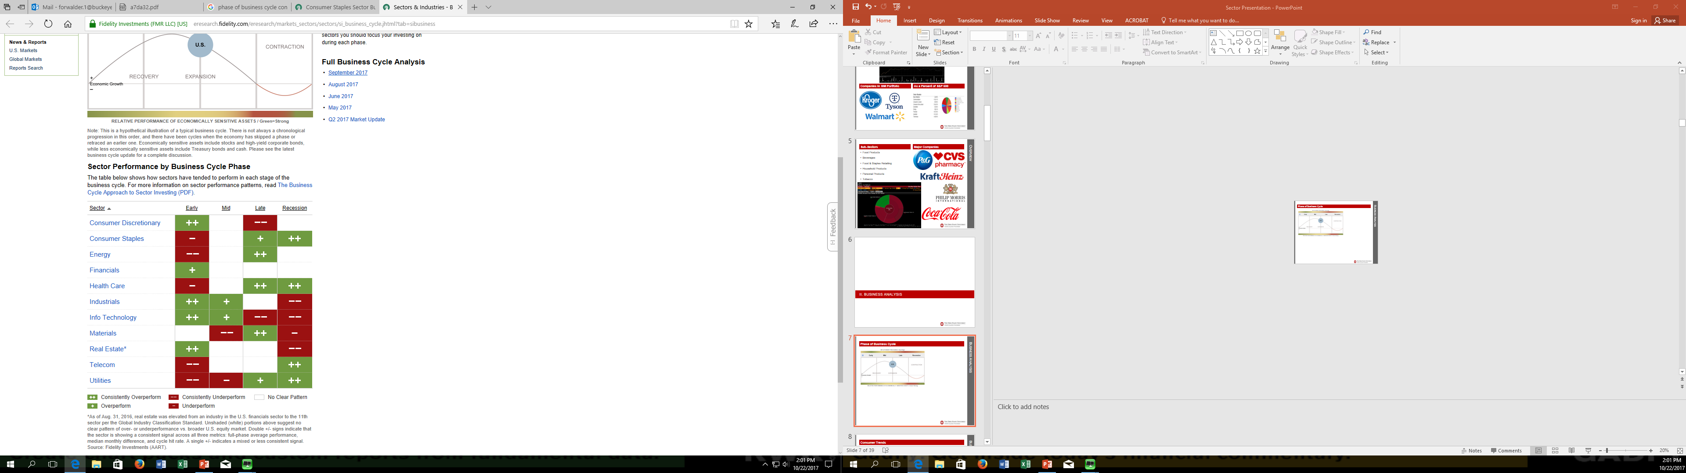
Business Analysis
Phase of Business Cycle
U.S. between mid- and late-cycle phase
Global economy in synchronized expansion with low recession risk
Upside to global economic momentum may have peaked
Steady dividends and low volatility make this traditionally stable sector more attractive to investors late in the business cycle

Slide 9
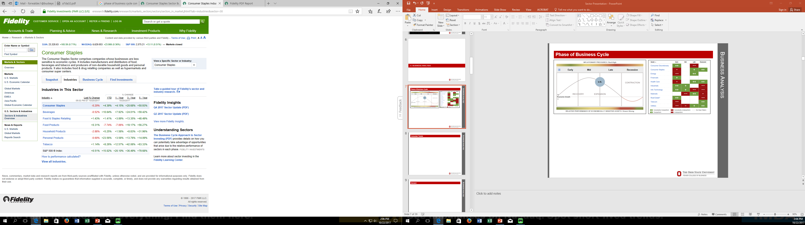
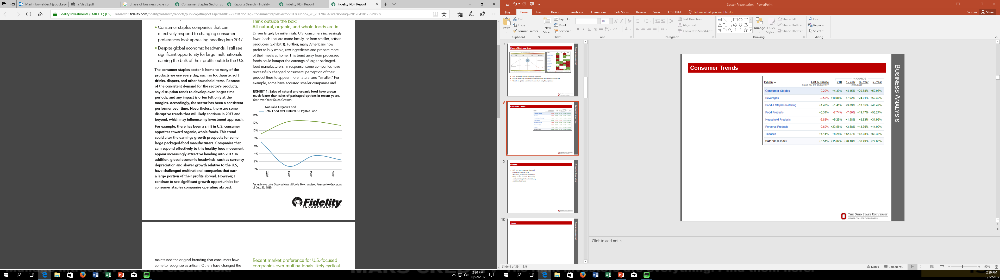
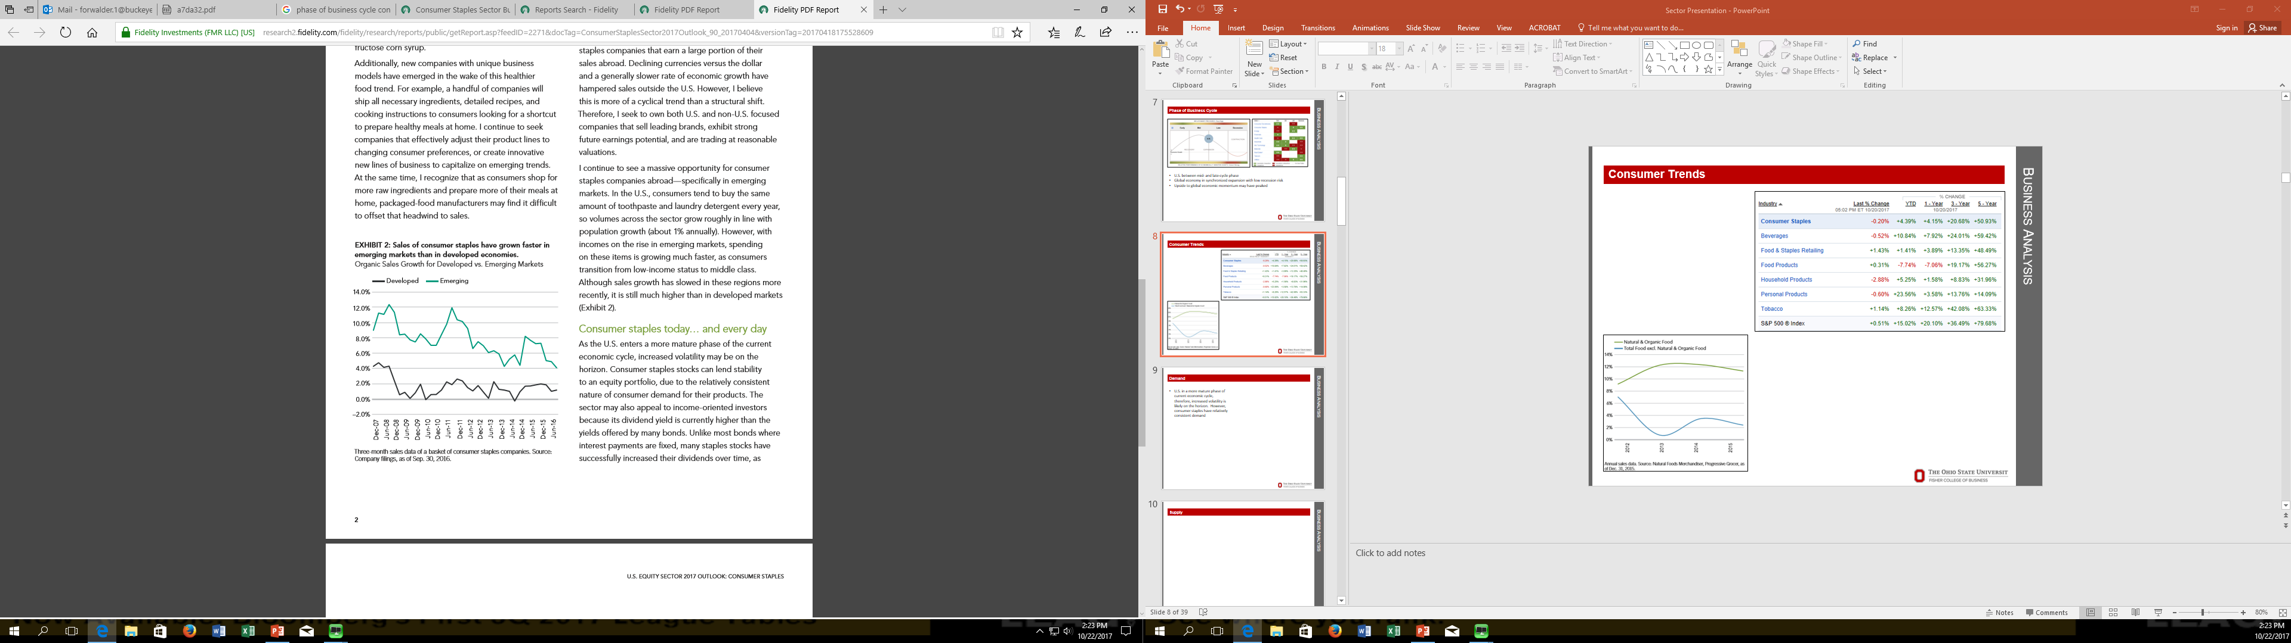
Business Analysis
Consumer Trends
Personal Products highest YTD returns
Natural & organic foods continue to show faster YOY sales growth
Sales of consumer staples have grown faster in emerging markets

Slide 10
Business Analysis
Supply & Demand
Non-Cyclical / Defensive
Suppliers easily match the demand given the relatively consistent nature of the sector
Demand for the products usually grows in relation to overall population growth, excluding specific trends

Slide 11
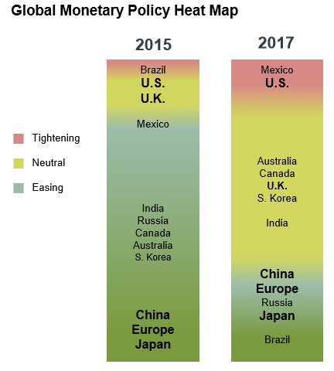
Business Analysis
Risks
Disconnect between the market’s and the Federal Reserve’s expectations of tightening
Shift toward global monetary policy normalization likely impact high dividend yielding sectors
Competition continues to accelerate due to the growth of low-cost emerging market production
Commodity deficits - declining Chinese industrial growth

Slide 12
Business Analysis
Competitive Analysis
Topic | Sub-Sectors | Explanation
Brand Momentum | Beverages | Certain brands have experienced significant growth recently (La Croix, Bai, etc.)
Distribution Momentum | Personal Products | Consumers are becoming more conscious of appearance and makeup is becoming more heavily sold
Consumer Trends | Food/Beverages Tobacco | Consumers are shifting more towards healthy foods/drinks Tobacco usage in the US is steadily declining and new FDA regulations are on the horizon
Niche Brand & Private Label Threat | Household Products Personal Products | Niche brands are beginning to steal market share (Dollar Shave Club, BeardBrand, etc.) As categories grow, they become more appealing for private labels
Amazon Threat | Food Staples & Retailing | Amazon has begun to directly compete with large retailers Amazon is growing their private label businesses in multiple segments

Slide 13
III. Economic Analysis

Slide 14
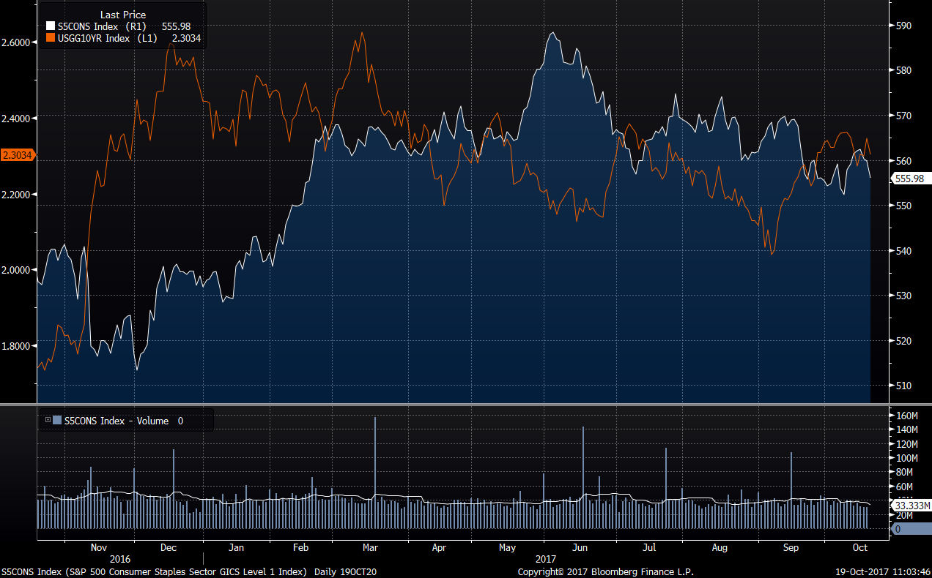
Economic Analysis
U.S 10-Year Treasury vs. Consumer Staples

Slide 15
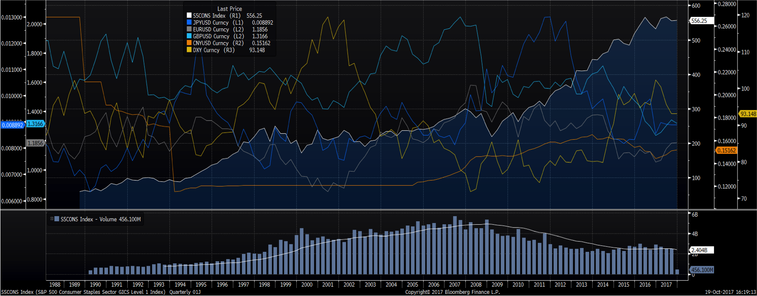
Economic Analysis
World Currencies vs. Consumer Staples

Slide 16
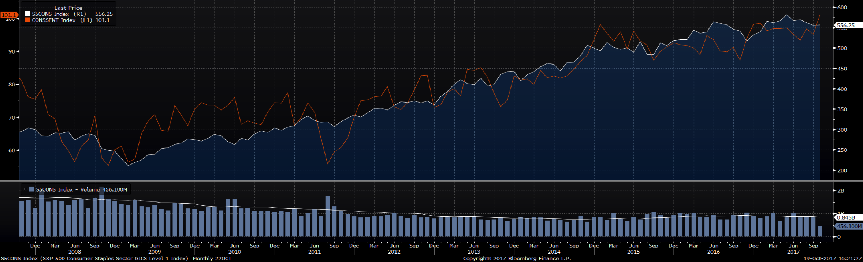
Economic Analysis
Consumer Sentiment vs. Consumer Staples

Slide 17
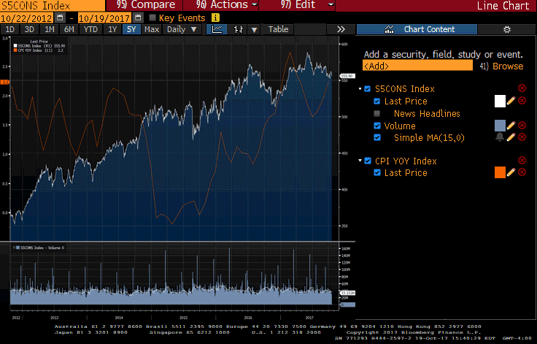
Economic Analysis
CPI vs. Consumer Staples

Slide 18
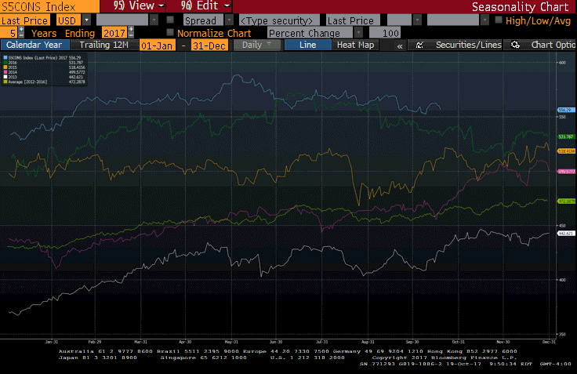
Economic Analysis
Seasonality Effects On Consumer Staples

Slide 19
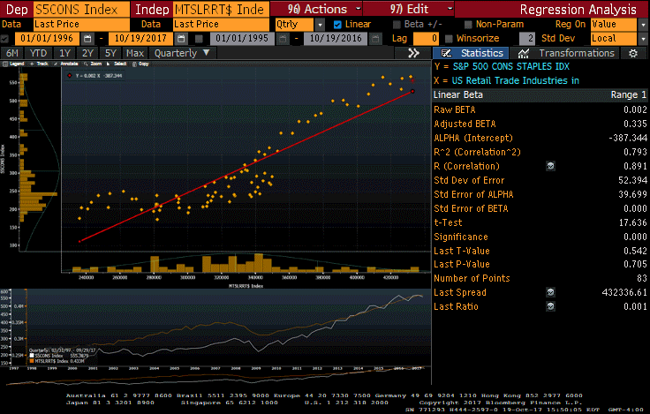
Economic Analysis
U.S. Retail Trade Industries vs. Consumer Staples

Slide 20
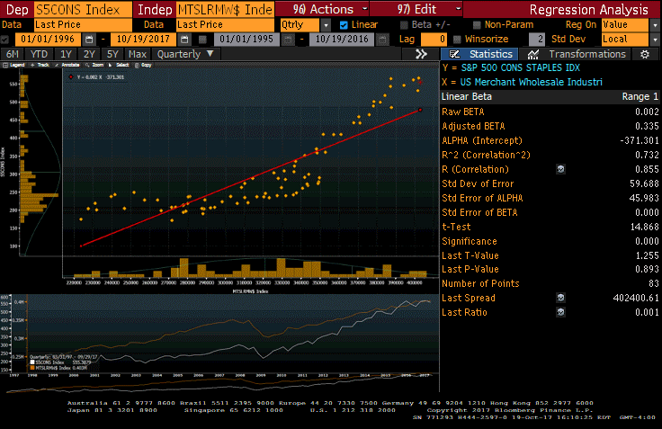
Economic Analysis
U.S. Merchant Wholesale Industry vs. Consumer Staples

Slide 21
Economic Analysis
GDP Of World Economies

Slide 22
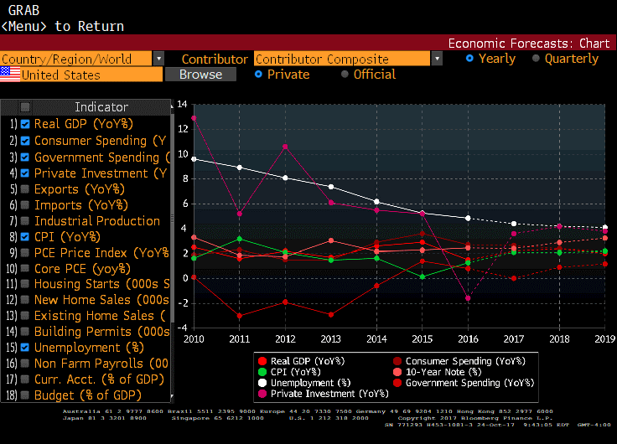
Economic Analysis
Economic Forecast

Slide 23
IV. Financial Analysis

Slide 24
Financial Analysis
Staples Sales Growth
Staples EBITDA Growth
Staples Earnings Growth

Slide 25
Financial Analysis
Sub-Sector Sales 3 Year Growth
Sub-Sector EBITDA 3 Year Growth
Most sub-sectors have seen little or negative growth recently
Sub-Sector Earnings 3 Year Growth

Slide 26
Financial Analysis
Profitability

Slide 27
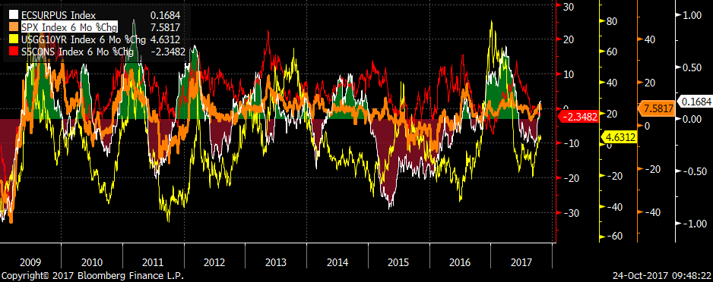
Financial Analysis
Economic Surprise vs. Consumer Staples & S&P500

Slide 28
Financial Analysis
Consumer Staples Surprise Effects
Ticker | Name | EPS % Surprise Last | Sales % Surprise Last | EPS % Surprise Annual | Sales % Surprise Annual
 | Investable Universe (34) | 2.9 | 0.5 | 0.5 | 0.1
COTY | COTY INC | 22.95 | 3.57 | -15.54 | 0.81
HSY | HERSHEY CO/THE | 21.65 | 0.67 | 2.15 | -0.23
BF/B | BROWN-FORMAN CORP | 18.50 | 4.93 | -1.20 | -1.76
EL | ESTEE LAUDER COMPANIES | 18.32 | 1.34 | 2.11 | 0.38
CAG | CONAGRA BRANDS INC | 14.71 | 1.01 | 1.45 | -0.19
STZ | CONSTELLATION BRANDS INC | 14.08 | 1.10 | 1.68 | 0.36
ADM | ARCHER-DANIELS-MIDLAND CO | 10.46 | -7.46 | -1.45 | 0.06
MKC | MCCORMICK & CO | 8.42 | 1.69 | -0.31 | -0.16
TSN | TYSON FOODS INC | 7.83 | 4.08 | -4.19 | -0.65
CHD | CHURCH & DWIGHT CO INC | 5.67 | -0.64 | 0.96 | 0.20
K | KELLOGG CO | 5.43 | 1.07 | 1.46 | 0.24
MDLZ | MONDELEZ INTERNATIONAL INC | 5.03 | -1.58 | -0.25 | -0.64
KMB | KIMBERLY-CLARK CORP | 3.96 | -0.31 | 0.55 | 0.00
PEP | PEPSICO INC | 3.42 | -0.42 | 1.08 | 0.18
COST | COSTCO WHOLESALE CORP | 3.32 | 1.64 | 0.31 | 0.62
TAP | MOLSON COORS BREWING CO | 3.30 | -0.45 | -1.70 | -8.3
KHC | KRAFT HEINZ CO/THE | 3.26 | -0.76 | 0.54 | 0.47

Slide 29
Financial Analysis
Consumer Staples Surprise Effects (Cont.)
Ticker | Name | EPS % Surprise Last | Sales % Surprise Last | EPS % Surprise Annual | Sales % Surprise Annual
 | Investable Universe (34) | 2.9 | 0.5 | 0.5 | 0.1
WBA | WALGREENS BOOTS ALLIANCE INC | 2.62 | 1.27 | 1.88 | -0.45
CLX | CLOROX COMPANY | 2.61 | 0.11 | 0.56 | 0.07
KO | COCA-COLA CO/THE | 2.60 | 0.62 | -0.05 | 0.70
CVS | CVS HEALTH CORP | 1.75 | 0.74 | 0.56 | -0.29
PG | PROCTER & GAMBLE CO/THE | 1.20 | -0.18 | 1.92 | 0.09
WMT | WAL-MART STORES INC | 0.84 | 0.16 | 0.16 | 0.03
SYY | SYSCO CORP | 0.69 | 0.50 | 0.44 | 0.05
CL | COLGATE-PALMOLIVE CO | -0.13 | -1.69 | -0.24 | -0.84
KR | KROGER CO | -0.51 | 0.40 | 0.76 | 0.16
MO | ALTRIA GROUP INC | -1.04 | 0.97 | 0.03 | -0.43
DPS | DR PEPPER SNAPPLE GROUP INC | -2.26 | 1.62 | -0.49 | 0.13
MNST | MONSTER BEVERAGE CORP | -3.50 | 0.63 | 4.60 | 0.91
CPB | CAMPBELL SOUP CO | -5.62 | -1.42 | -0.26 | -0.29
SJM | JM SMUCKER CO/THE | -6.61 | -3.58 | 1.17 | 0.18
GIS | GENERAL MILLS INC | -7.18 | -0.80 | 0.91 | 0.37
HRL | HORMEL FOODS CORP | -7.88 | -1.23 | -0.24 | 0.11
PM | PHILIP MORRIS INTERNATIONAL | -8.23 | -3.59 | -0.17 | 1.15

Slide 30
V. Valuation Analysis

Slide 31
Valuation Analysis
Historical P/E Multiple
Historical P/B
Historical Dividend Yield
Historical Free Cash Flow Yield

Slide 32
Valuation Analysis
Sub Sector Valuation Comparison
Sector/Sub-Sector | Current P/E | 30 Year Average P/E | Over/Under
S&P 500 | 21.8 | 19.9 | 9.8%
Consumer Staples | 21.0 | 20.0 | 4.8%
Beverages | 23.4 | 23.7 | (-1.6%)
Food & Staples Retailing | 18.1 | 19.9 | (-9%)
Food Products | 18.4 | 19.6 | (-6.3%)
Household Products | 22.4 | 21.8 | 2.5%
Personal Products | 32.36 | 24.76 | 30.7%
Tobacco | 22.7 | 15.1 | 50.4%

Slide 33
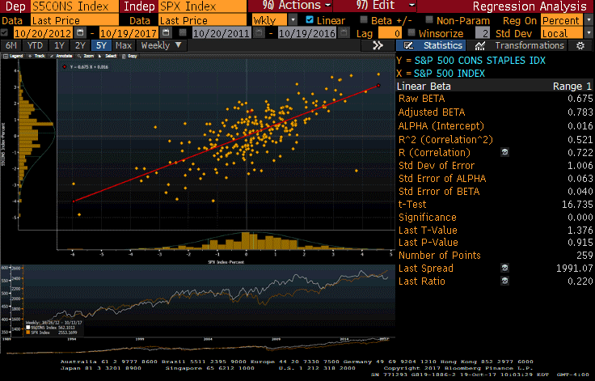
Valuation Analysis
Staples vs S&P 500

Slide 34
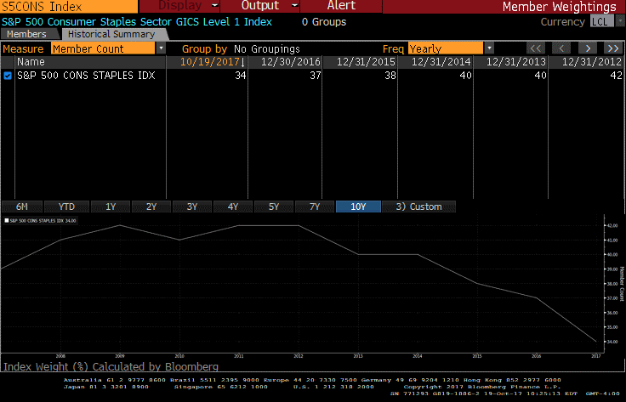
Valuation Analysis
Members Within Index

Slide 35
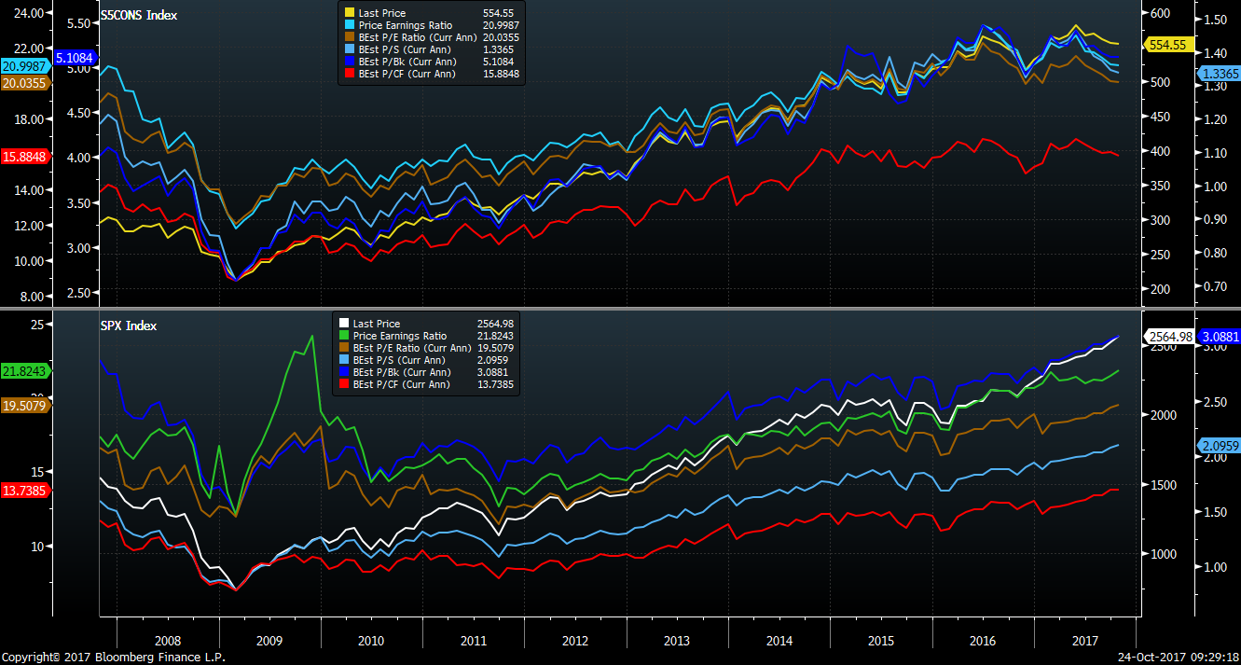
Valuation Analysis
S&P vs. Consumer Staples: 10-Year Historical Comparison

Slide 36
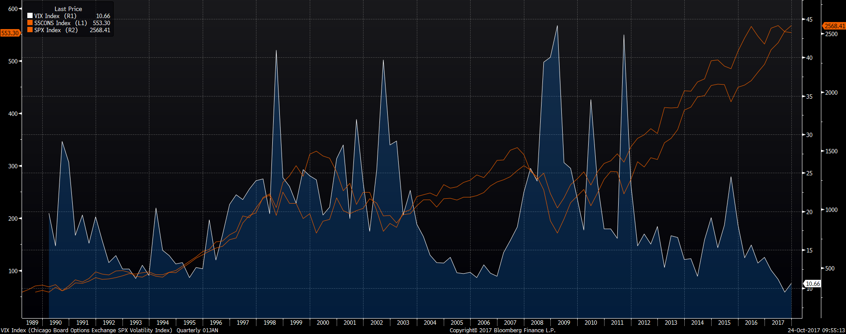
Valuation Analysis
VIX Index vs. Consumer Staples & S&P500

Slide 37
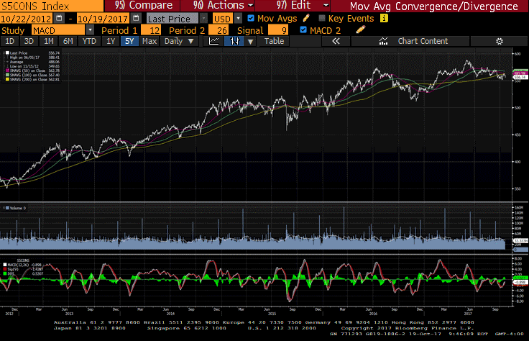
Valuation Analysis
Technical Analysis: MACD

Slide 38
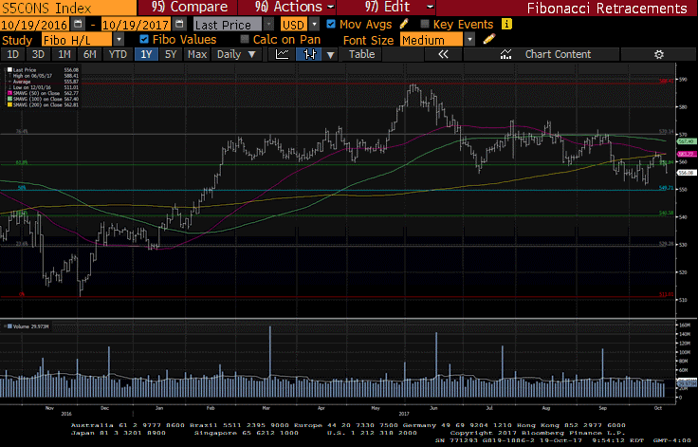
Valuation Analysis
Technical Analysis: Fibonacci Retracements

Slide 39
VI. Recommendation

Slide 40
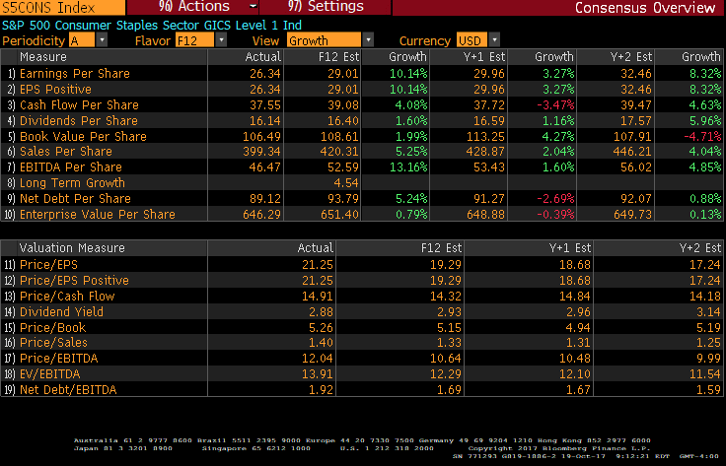
Recommendation
Consensus Overview

Slide 41
Recommendation
Our Recommendation
Major Positives:
Leaves room to invest in sectors yielding potential higher returns
Potential price correction of non-cyclical investments could allow the sector to be re-entered at more reasonable multiples
Major Risks:
Recessionary phase of the business cycle could approach sooner than expected and staples could outperform
Geopolitical risks could inflate demand for safer equity investments

